Slide 1
SearchEngineRetrEvil Tim Sporleder, Manuel Zedel Search Engine Implementation Seminar

Slide 2
General facts about our implementation
Indexing time: ~ 2.5h
Using Lucene for pre-processing
lower case, tokenizing, stemming
+ stopword removal using custom list
SAX Parser for parsing
Everything else is Java 6
Redirection pages are not indexed
Supports link queries, boolean queries, keyword queries, BM25, Pseudo relevance feedback, ..

Slide 3
Implementation details
if (term.equals(readTerm)) {
// return offset
raSeekListFile.close();
return readOffset;
} else {
// recalculate offset
if (term.compareTo(readTerm) < 0) {
// term < readTerm, go left
rightOffset = offset;
offset -= (offset - leftOffset) / 2;
if (offset < 0) {
break;
}
} else {
// term > readTerm, go right
offset = raSeekListFile.getFilePointer();
leftOffset = offset;
offset += (rightOffset - offset) / 2;
if (offset > (raSeekListFile.length() - 1)) {
break;
}
}
}
Linkindex doesn’t use a seeklist
Binary search on the text file
Frees up space in memory
Just used for linkto queries, since those are rarer and easy to answer

Slide 4
Implementation details
The seeklist caused strange memory problems when it was parsed
E.g.:
225 MB free of total: 1630 MB Exception in thread "main" java.lang.OutOfMemoryError: Java heap Space at java.util.Arrays.copyOfRange(Arrays.java:3658) at java.lang.String.<init>(String.java:201) at java.lang.StringBuilder.toString(StringBuilder.java:407) at de.hpi.krestel.mySearchEngine.IndexHandler .loadIndex(IndexHandler.java:934)

Slide 5
Implementation details
Instead the seeklist now also is searched via binary search
Prefix queries requires additional steps:
Upon first found entry of a prefix -> go back to previous entries and show all
// keep reading terms which start with the prefix
do {
// read the next line
line = raSeekListFile.readLine();
// get term
parts = line.toString().split("\t");
readTerm = parts[0];
// add if correct
if (readTerm.startsWith(prefix)) {
terms.add(readTerm);
}
} while (readTerm.startsWith(prefix));

Slide 6
Implementation details
Terms in the partial indexes are Base64 encoded
to include connected terms

Slide 7
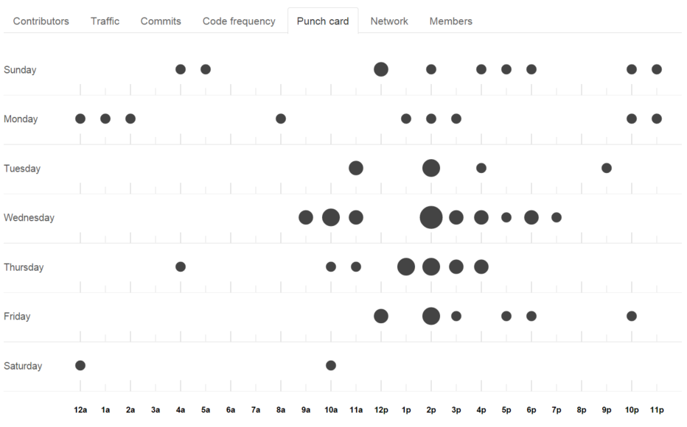
Questions?!

